Slide 1

Social and health inequality over 30 years: What’s changed?
Presented by John Glover
18 October 2024
PHIDU
Notes:
.

Slide 2
Outline
There are many stories in the data we have published dating back to the mid- to late-1980s, published in Social Health Atlases for South Australia from 1990 and for Australia from 1992.
I will talk about three topics, two of which have come to be seen as bigger challenges over this period, and one of which is still acknowledged as a concern but is not a focus of direct action by government.
Overweight and obesity
Mental ill-health
Premature mortality

Slide 3
Overweight and Obesity, Over time
Overweight and obesity is a major public health issue, with nearly 2 in 3 adults in Australia considered overweight or obese.
The Australian Burden of Disease Study 2011 modelled the impact of overweight and obesity and showed it is one of the leading risk factors for ill health and death; enhanced analysis showed that 7.0% of the total health burden in Australia in 2011 was due to overweight and obesity, and that this burden increased with increasing level of socioeconomic disadvantage.

Slide 4
Overweight and Obesity, Over time

Slide 6
People aged 15 years and over (1995) and 18 years and over (other years) (proportions - %)

Slide 7
People aged 15 years and over (1995) and 18 years and over (2022) (numbers and proportions - %)

Slide 8
Children aged 2–17* years (proportions - %)
* 5 to 17 years of age in 1995

Slide 9
Mental ill-health
Over the period from 2020–22, the ABS conducted the National Study of Mental Health and Wellbeing (NHSMHWB).
This was the first mental health-specific survey since 2007.
The Study revealed relatively high prevalence of 12-month mental health disorders
- Anxiety disorders, Affective (or mood) disorders and Substance Use disorders.
The following groups had any of these 12- month disorders:
Over one in five people aged 16 to 85 years (21.5%)
Almost two in five young people aged 16 to 24 years (38.8%, or over 1m)
40% higher among young females (cf. males: 66% higher for anxiety disorders and 61% for affective disorders, but almost half the level for substance use disorders)
601,000 young females; 449,000 young males
Similar, but lower, proportions at ages 25 to 34 years

Slide 10
Persons 16–85 years, 12-month mental disorder groups by age and sex

Slide 11
Rate ratios: Female: Male proportions, selected ages,
12-month mental disorder group

Slide 12
Rate ratios: Selected characteristics, 12-month mental disorder group

Slide 13
Rate ratios: Selected characteristics, 12-month mental disorder group …cont.

Slide 14
Rate ratios: Selected characteristics, 12-month mental disorder group …cont.

Slide 15
Rate ratios: Selected characteristics, 12-month mental disorder group …cont.

Slide 16
Change over time, 12-month mental disorder groups, 2007 and 2020–2022
There have been substantial increases over many years in the reporting of mental health conditions in the NHS’s and state-based reporting systems, based on self-reported data – nearly two and a half times the proportion in 2022 cf. 2004—05.
It is difficult to determine the extent to which the increase is due to an increase in the propensity to report, as mental health issues became more widely spoken about, or to an increase in the prevalence of these conditions.
However, the 2007 (as adjusted by the ABS for comparability with the later Study) and 2020 to 2022 data are clinically closely comparable.
They show an increase, over 15 years, from 19.5% to 21.5% at 16 to 85 years of people with any 12-month mental disorder.
The ABS have reported that all of the increase, of two percentage points, came from the 16 to 24 year age group. And the change is largely driven by an increased prevalence among females in this age group.

Slide 17
Any 12-month mental disorder, population 16–24 years, by sex, 2007 and 2020 to 2022

Slide 18
Any 12-month mental disorder, 16–85 years, by socioeconomic disadvantage of area, 2007 and 2020 to 2022

Slide 19
Premature mortality over time
Death rates over time (deaths at all ages and at ages 0 to 74 years)

Slide 20
Premature mortality, Over time

Slide 21
Equity gap: changes over time in premature mortality, by socioeconomic disadvantage

Slide 22
Equity gap: changes over time in premature mortality, by socioeconomic disadvantage

Slide 23
The social gradient in premature mortality rates, Australia, 2022

Slide 24
Aboriginal and non-Indigenous premature mortality (0 to 64 years), over time, Australia*
Notes: Vertical axis scale for non-Indigenous is one quarter that for Aboriginal deaths
For IRSEO, high index values indicate poorer outcomes; for IRSD, high index values indicate relative advantage
Rate ratios
* ‘Australia’ comprises NSW, Qld, SA, WA & NT

Slide 25
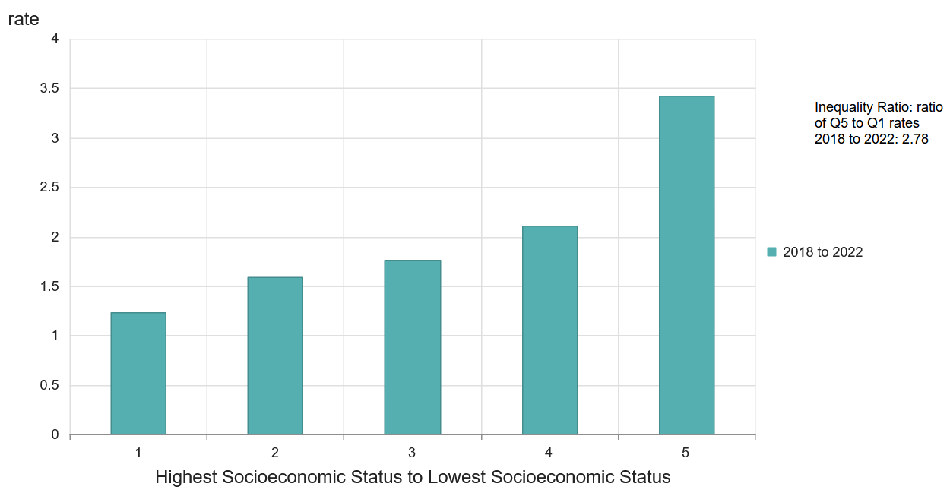
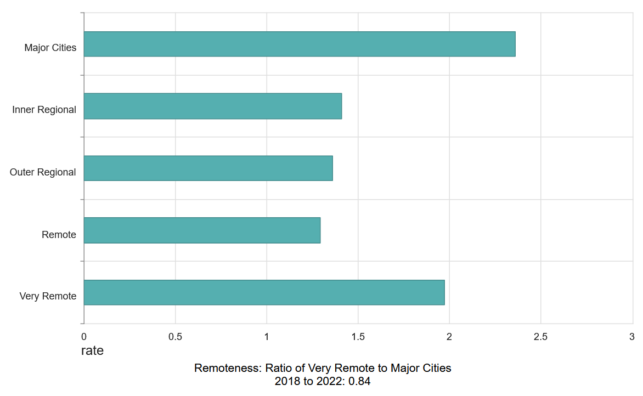
FYI, Premature mortality (2018 to 2022) from COVID-19

Slide 26
To draw this to a close ….
Two indicators which highlight one of the uses of the Social Health Atlas

Slide 27
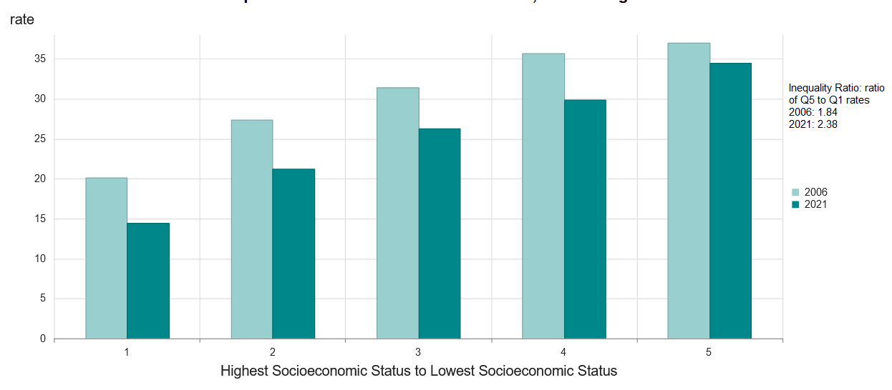
People who left school at year 10 or below, or did not go to school

Slide 28
Correlation between rates of people who left school at Year 10, or earlier and selected variables,
at the Population Health Area level, Greater Adelaide and Greater Sydney
From early childhood
Adelaide Sydney
Children in very low-income (welfare-dependent) families (r= 0.70) (r= 0.64)
Mothers smoking during pregnancy (r= 0.79) (r= 0.76)
Children reporting having two long-term health conditions (r= 0.53) (r= 0.59)
Infant deaths (r= 0.61) (r= 0.08)
Into adulthood
Youth unemployment (r= 0.83) (r= 0.61)
Youth mortality: 15 to 24 yrs (r= 0.41) (r= 0.38)
Adults reporting three or more long-term health conditions (r= 0.65) (r= 0.81)
Poor results from bowel screening (r= 0.86) (r= 0.75)
cf. participation (inverse correlation) (r= -0.74) (r= -0.17)
Premature mortality: 0 to 74 years (r= 0.79) (r= 0.66)
Hospitalisations (public acute hospitals) (r= 0.79) (r= 0.31)
Potentially preventable hospitalisations (r= 0.79) (r= 0.36)

Slide 29
Left school at age 15 years or earlier, 1986 and Left school at Year 10 or earlier, 2021
at the Population Health Area level, Greater Adelaide
These maps for Greater Sydney, Melbourne and Brisbane at https://atlasesaustralia.au/historical/atlas.html

Slide 30
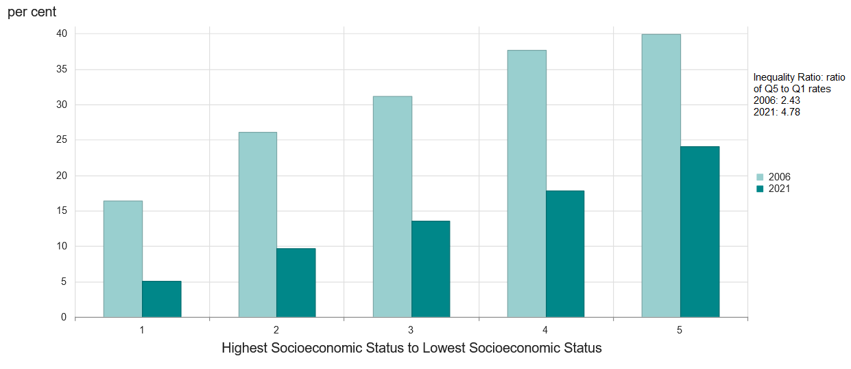
Children (under 15 years) where the mother has low educational achievement, Australia
A strong and consistent decline – 2006: 30.6%; 2011: 23.5%; 2016: 18.3%; 2021: 14.1% – with a widening equity gap

Slide 31
Final words

Slide 32
Thank you
We at PHIDU acknowledge the long-term support of the Commonwealth through the Department of Health and Aged Care through its funding of this work for over 25 years.
We also thank the efforts of those collecting the data on which we rely, and hope we add value to by presenting in the Social Health Atlas.
And I want to thank the PHIDU staff for their role in maintaining such a high level and quality of output.
If you have any questions or comments, please unmute and go ahead.
A recording of this presentation and a copy of the PowerPoint and notes will be available from the PHIDU website at this link by the middle of next week:
https://phidu.torrens.edu.au/publications/all-publications and please scroll down to ‘Presentations’,

